Slide 1

Android Tutorials
By : Piyush Khandelwal

Slide 2
PendingIntent
Android PendingIntent is an object that wraps up an intent object and it specifies an action to be taken place in future.
PendingIntent lets us pass a future Intent to another application and allow that application to execute that Intent.
A PendingIntent provides a means for applications to work, even after their process exits.
AlarmManager, Notification

Slide 3
PendingIntent
PendingIntent uses the following methods to handle the different types of intents:
PendingIntent.getActivity() : Retrieve a PendingIntent to start an Activity
PendingIntent.getBroadcast() : Retrieve a PendingIntent to perform a Broadcast
PendingIntent.getService() : Retrieve a PendingIntent to start a Service

Slide 4
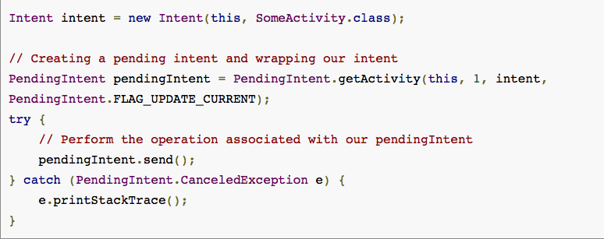
1. this (context) : This is the context in which the PendingIntent starts the activity
2. requestCode : “1” is the private request code for the sender used in the above example. Using it later with the same method again will get back the same pending intent. Then we can do various things like cancelling the pending intent with cancel(), etc.

Slide 5
3. intent : Explicit intent object of the activity to be launched
4. flag : One of the PendingIntent flag that we’ve used in the above example is FLAG_UPDATE_CURRENT.
This one states that if a previous PendingIntent already exists, then the current one will update it with the latest intent.
There are many other flags like FLAG_CANCEL_CURRENT etc.

Slide 6
Notification
Android notification is a message that we can display to the user outside of our application’s normal UI.
Notifications in android are built using NotificationCompat library.
Creating Android Notification
The Notification.Builder provides an builder interface to create an Notification object as shown below

Slide 7
Android Notification Methods
Notification build() : Combines all of the options that have been set and returns a new Notification object
NotificationCompat.Builder setAutoCancel (boolean autoCancel) : Setting this flag will make it such that the notification is automatically canceled when the user clicks it in the panel
NotificationCompat.Builder setContent (RemoteViews views) : Supplies a custom RemoteViews to use instead of the standard one
NotificationCompat.Builder setContentInfo (CharSequence info) : Sets the large text at the right-hand side of the notification
NotificationCompat.Builder setContentIntent (PendingIntent intent) : Supplies a PendingIntent to send when the notification is clicked
NotificationCompat.Builder setContentText (CharSequence text) : Sets the text (second row) of the notification, in a standard notification
NotificationCompat.Builder setContentTitle (CharSequence title) : Sets the text (first row) of the notification, in a standard notification

Slide 8
Android Notification Button and Styles
The Notification.Builder allows you to add up to three buttons with definable actions to the notification.
Android 4.1 and above support expandable notifications which shows a big view of the notification when it is expanded.
There are three styles that can be used with the big view: big picture style, big text style, Inbox style.

Slide 9
Cancelling Android Notification
We can also call the cancel() for a specific notification ID on the NotificationManager.
The cancelAll() method call removes all of the notifications you previously issued.

